Slide 1

Presented By:
Aileen Kate Fu

Slide 2
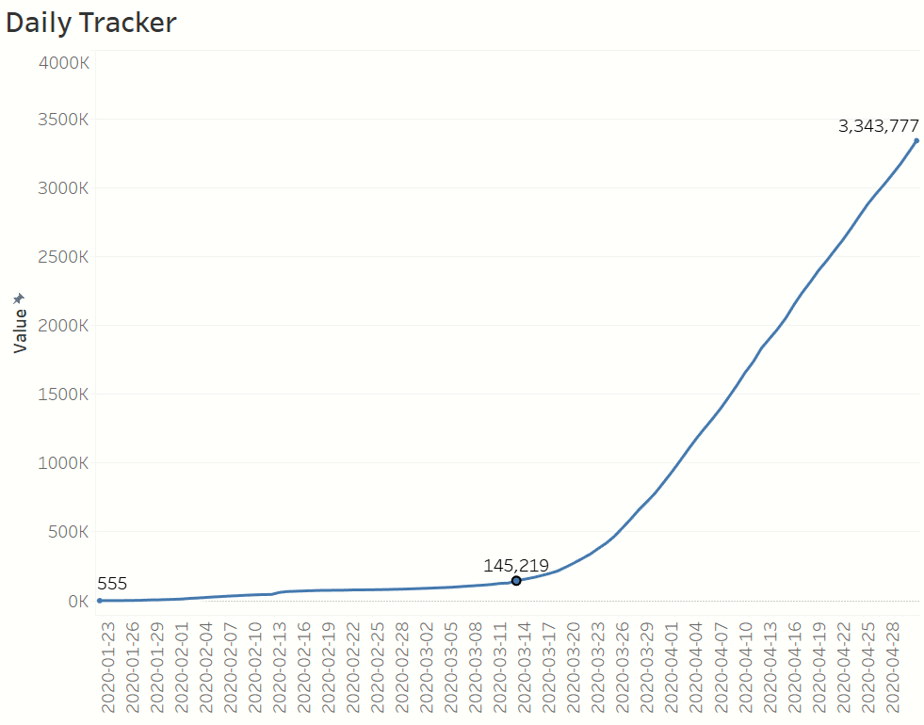
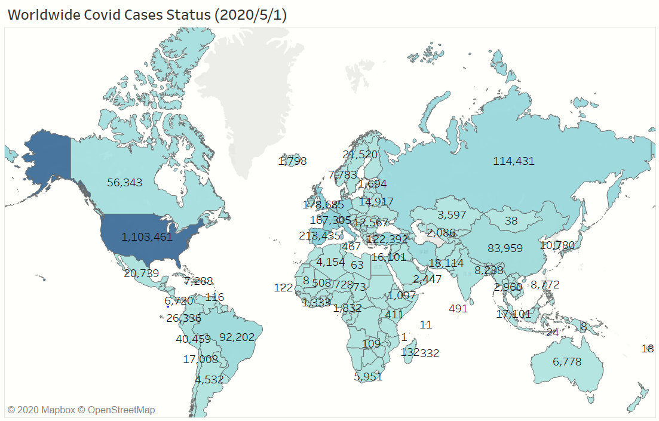
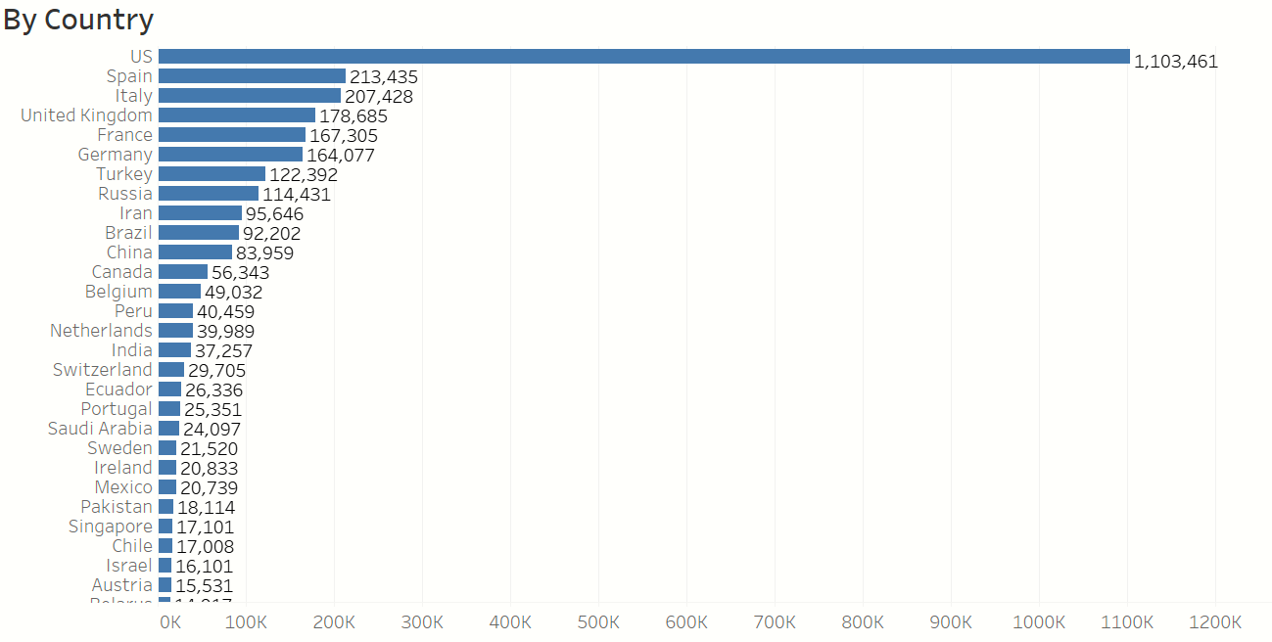
Worldwide
Key Insights:
Growth turning point: In the middle of March
Current Updates: US total cases are far more than those of following countries

Slide 3
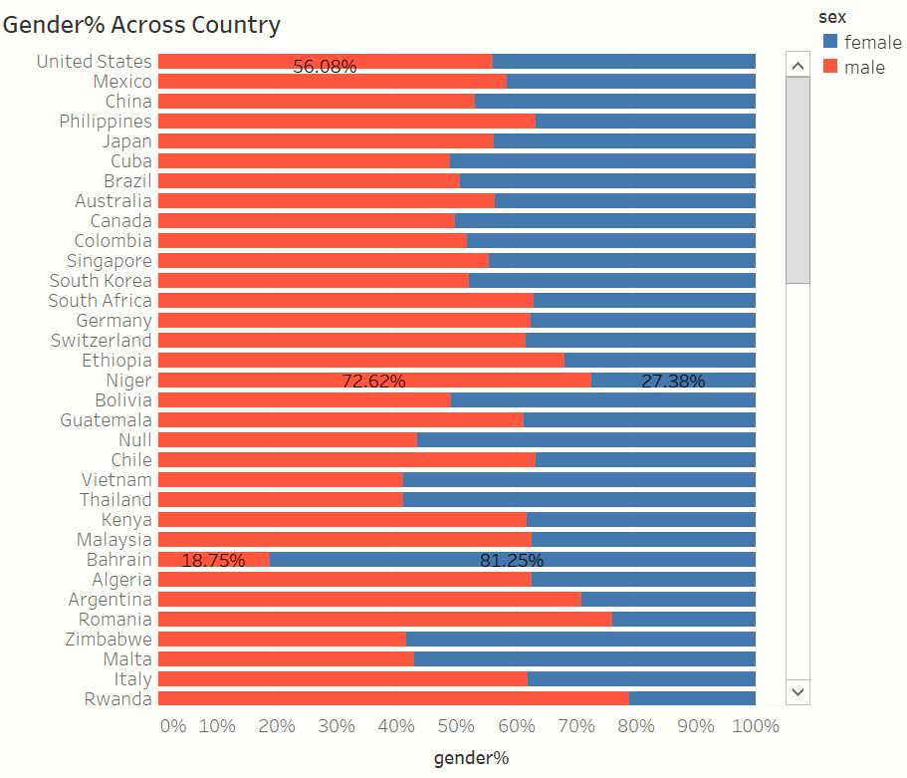
Major Countries
Key Insights
Monthly growth
A very big jump for US and Italy
Daily growth
Sharp growth rate for US, Spain and UK;
Rapid growth rate for Italy;
slow-down growth for China
Two turning points observed from China
1st breakout in January;
2nd break out in the middle of February
Gender% across countries
No obvious gender difference

Slide 4
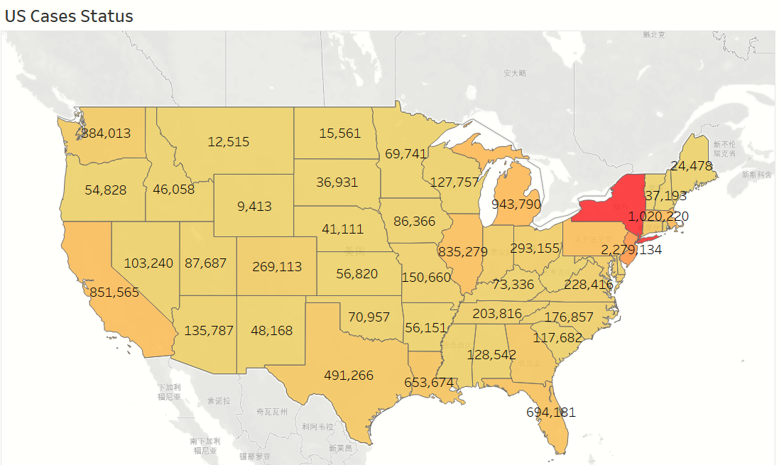
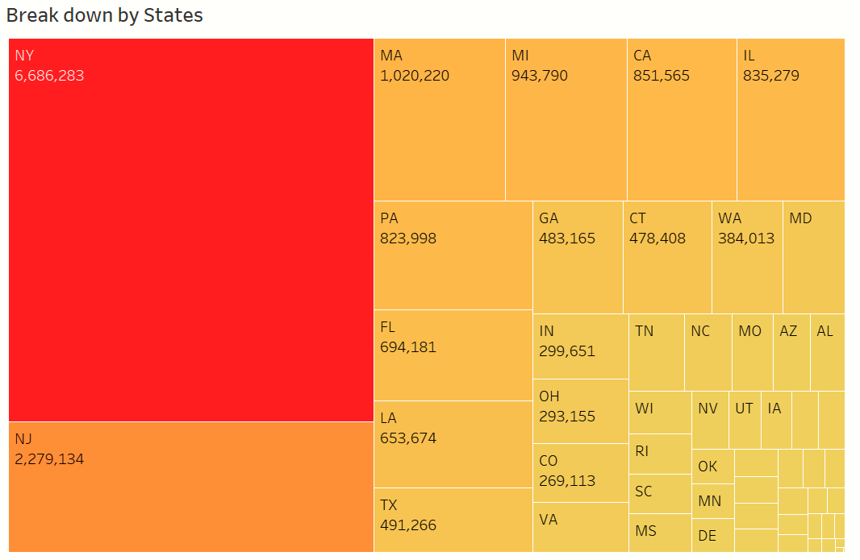
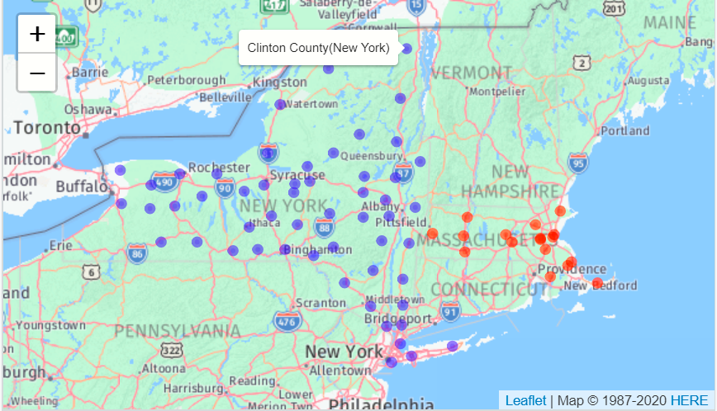
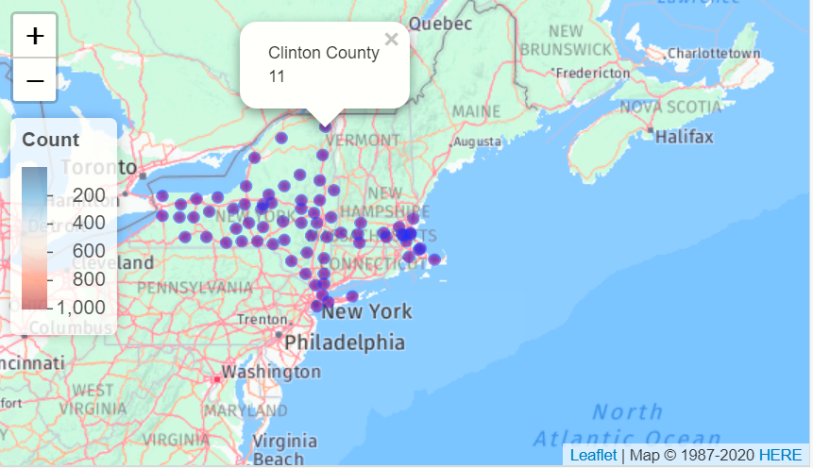
United States
New York is the leading state, followed by New Jersey and Massachusetts
Color NY and MA;
Display city and count

